Slide 1
Example Perplexity and Class Label Cleaning XIE WEIYAN, Vayne
QIU, Yaowen | yqiuau@connect.ust.hk
CHIU, King Yuen | kychiuah@connect.ust.hk
SHEN, Yiqin | yshenbj@connect.ust.hk

Slide 2
Multiple students can work on the same project. You are encouraged to discuss and exchange ideas. However, you must carry out the project independently (code writing, experiments, report, oral presentation).

Slide 3
Example Perplexity image classification
Some examples are easier for humans to classify than others.
Example perplexity → the level of difficulty of classifying an example.
To estimate the perplexity of an image for DNNs, we create a population of DNN classifiers with varying architectures and trained on data of varying sample sizes (500 models).
ImageNet:
A Best model to make image classification (usually do)
Trained 500 models
Divide the whole dataset into several parts (25%, 50%, 75%...) 10
Select different model structures (resnet50, vgg16, googlenet…) 10 =100
At each time of model training, select models from different stage of training
Epoch 5, 10, 15, 20, 25
10*10*5=500 models weak and stronger model →

Slide 4
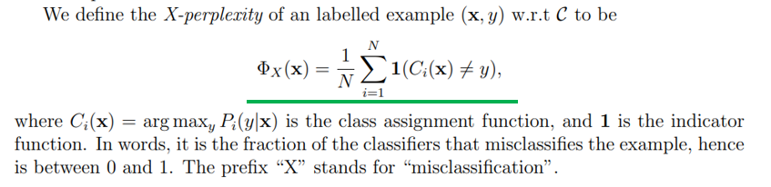
X- perplexity
Mistake / misclassification
500 models
Top-1 predicted class
First model: 1 0
0 1
1
0

Slide 5
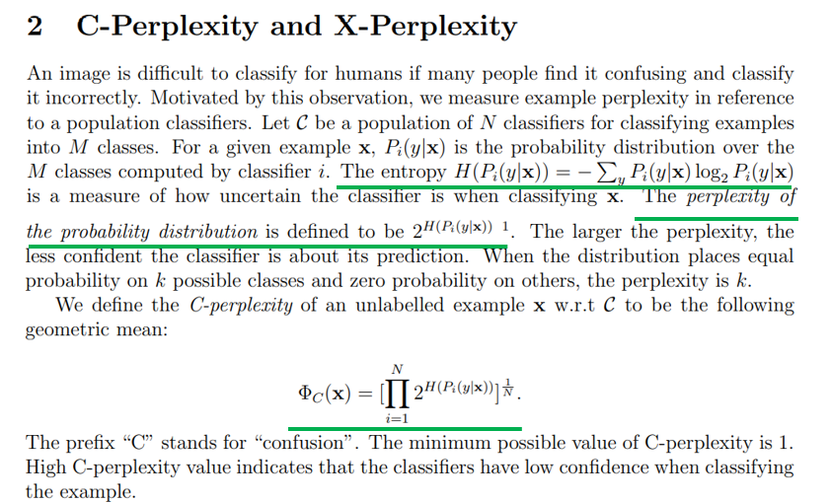


Confidence
Probability
[0.2, 0.4, 0.4]
K=6
1/6
=k
Hard to make decisions among 6 possible results
2, 3, 4
In the special case where p models a fair k-sided die (a uniform distribution over k discrete events), its perplexity is k.
Notes:
Hard to make decisions among 6 possible results

Slide 6
ImageNet
1000 Categories
https://observablehq.com/@mbostock/imagenet-hierarchy
Training set: about 1200 images/category* 1000 category = about 1.2 million images
Validation set: exactly 50 images/category* 1000 category = 50,000 images
One image → One label

Slide 7
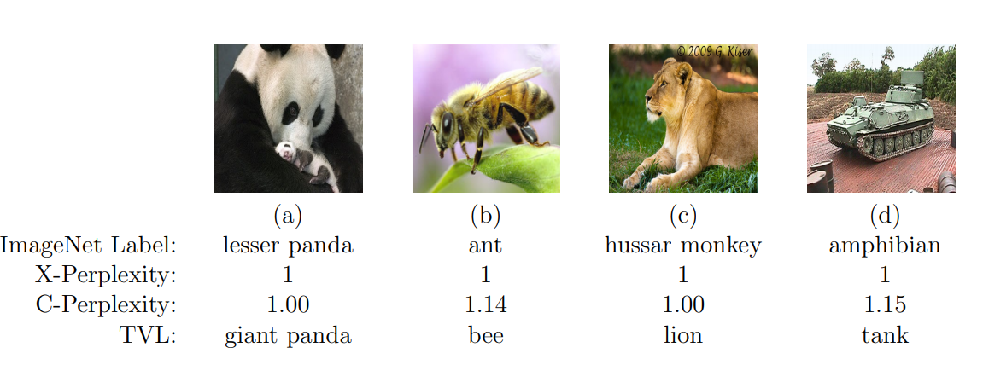
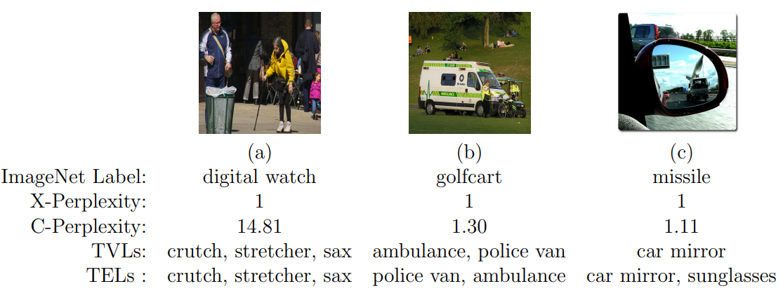
X=1
All 500 models misclassify the images
Explanation
Perplexity → Measurement of data quality
High X
High C → likely that there are multiple objects in the image

Slide 8
Create a subset of ImageNet training and validation sets by selecting examples with low C-perplexity (e.g., < 3) and X-perplexity (e.g., <0.9)
Select some architectures. For each one,
Train it on original training set, resulting in model1
Train it on “cleaned” training set, resulting model2
Compare model1 and model2 on “cleaned” validation set and original validation set
Expectation: model2 is better because it is trained on cleaner data
Try different c-p, x-p threshold combinations
Show what Feifan has done
Training set → data cleaning → ‘’cleaner’’ training set
Validation set → data cleaning → ‘’cleaner’’ validation set
data cleaning→ base on X/C perplexity
Train model on ‘’cleaner’’ training set → validate the model on the ‘’cleaner’’ validation set or original validation set
Baseline
Training set→ validation set (baseline)
‘’cleaner’’ training set → validation set (do not improve)
‘’cleaner’’ training set → ‘’cleaner’’ validation set (may improve)
’cleaner’’ validation set → is indeed “cleaner” (argue)
ResNet50 + Nvidia 2080 Ti + ImageNet = 1 or 2 day (30 hours)

Slide 9
Some Ideas:
We selected ResNet101 for the experiment,
Try more different models ? (some more recent models e.g. some attention models)
According to the set threshold, we select 500 images that meet the threshold for each category
Don’t do the selection, just use all the data after cleaning
If the model is better, try to find in whose examples, the performance is improved (any common pattern ?)
Rather than deleting the data, is it possible to assign weights to the data ?
Try to figure out how the model performance is related to the choices of X/C perplexity (threshold)
Some people train a model on ImageNet, and use it in another application. We can consider use such transfer learning setting to do evaluation.
Reading:
https://drive.google.com/drive/folders/1HvnRy-1VKMPIBbZOoLIKRSQGsPbsNl2w?usp=sharing

Slide 10
Technical Parts

Slide 11
Training set (137.74 GB):
https://drive.google.com/file/d/1W2GxqoMl245n7vE_IJUsf8lOx_DriqMU/view?usp=sharing
Validation set :
https://drive.google.com/file/d/1p4TpYtK5MX2I_H_s8jzOHde7IBsDM-2v/view?usp=sharing
Azure:
How to create Azure VM – YouTube
Azure Open License Activation User Guide.docx
https://docs.google.com/document/d/1uBS3635sOK4KB3m8EMUFk7609q4O3EmC/edit
2000/3000 HKD

Slide 12
Training Set:
X-Perplexity
https://drive.google.com/file/d/1XG4yTULZGWnDttbm6k_6HPtzx3pIC0ne/view?usp=sharing
C-Perplexity
https://drive.google.com/file/d/1mn9hDLqdbBSEBdlmKFv3O9ZOkPSMEwqF/view?usp=sharing

Slide 13
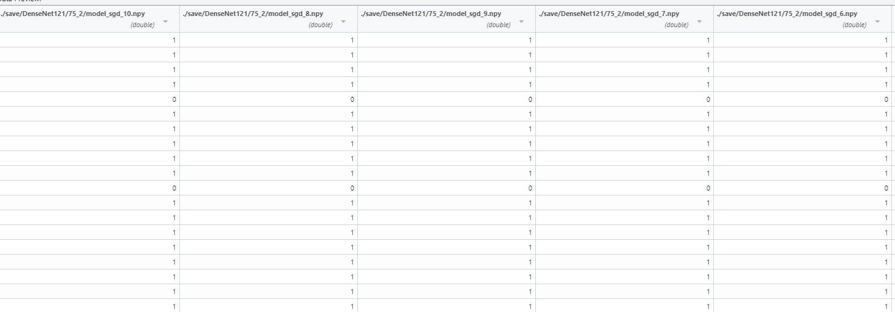
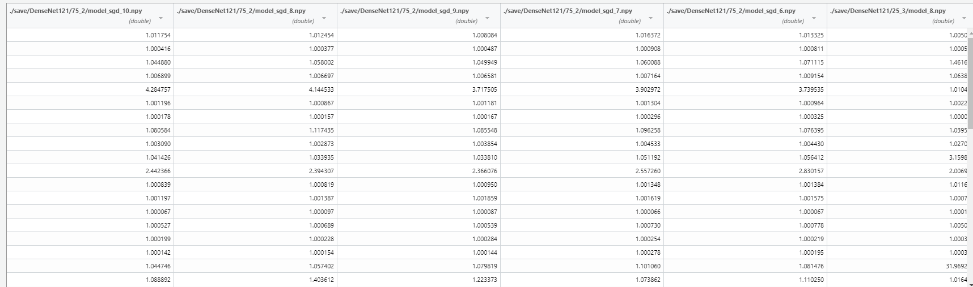


Slide 14
Validation Set:
https://drive.google.com/file/d/1IFi-qytTVEFSpTy-jEWaMKtc8lCuGYPv/view
zip
C2. Perplexity.csv
The .csv file includes the following columns:
file_name: file_name for the image
label: hand-annotated label for the image
c_perplexity: output C-Perplexity for this image
x_perplexity: output X-Perplexity for this image

Slide 15
Codes for ImageNet model training
https://drive.google.com/drive/folders/1SYPFIKN74tE_lTiSSnP7abIDcHsmJiBc?usp=sharing

